Slide 1
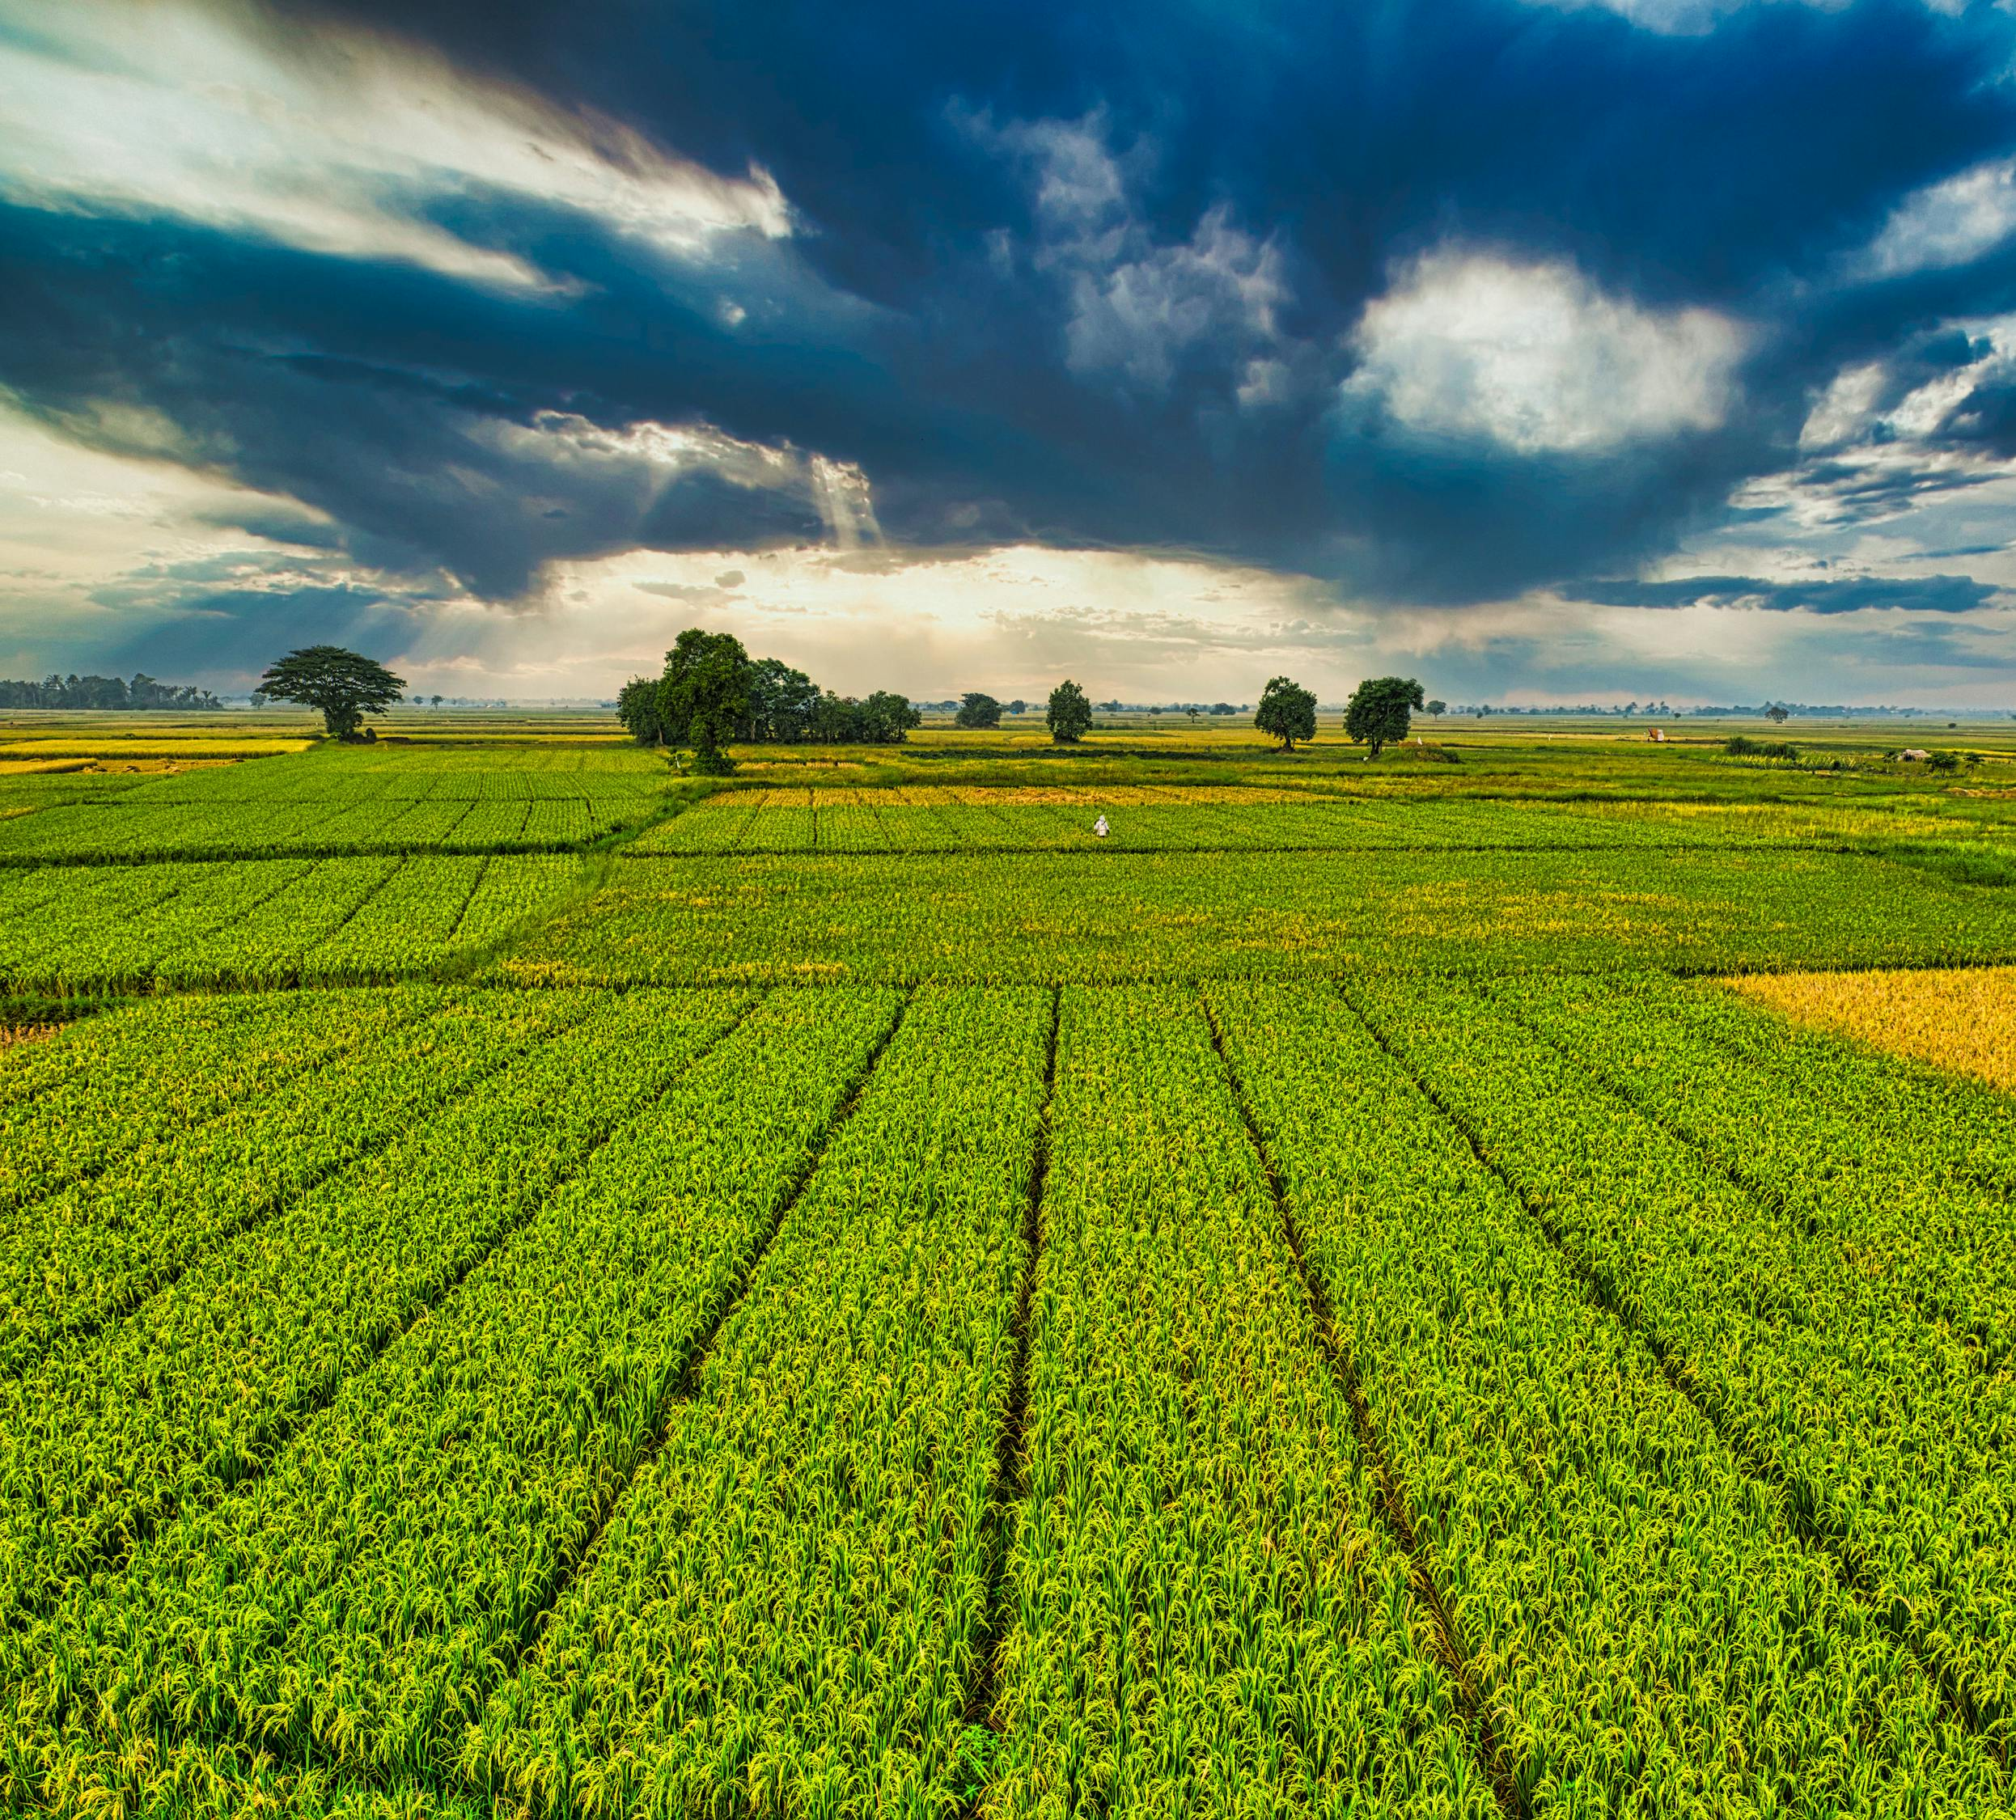

INDIAN AGRICULTURAL CROP PRODUCTION ANALYSIS
SREELAKSHMI P G
(DATA ANALYTICS)

Slide 2
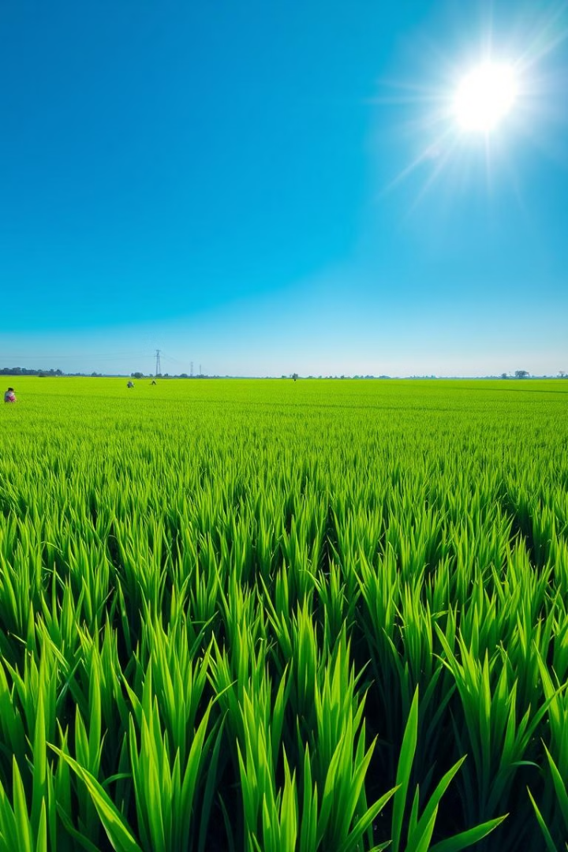
INTRODUCTION
This presentation analyzes trends in Indian agricultural production from 1997 to 2020, highlighting key factors impacting yield and production. We will examine national and regional trends across various crops, analyzing the impact of key factors on production.

Slide 3
OBJECTIVES
To analyse the crop varieties and total production throughout the years
To observe the top 5 crops in terms of yield and area coverage
To take a quick glance at seasonal contribution to production across South Indian states
To get a rough overview of Kerala’s production ability

Slide 4
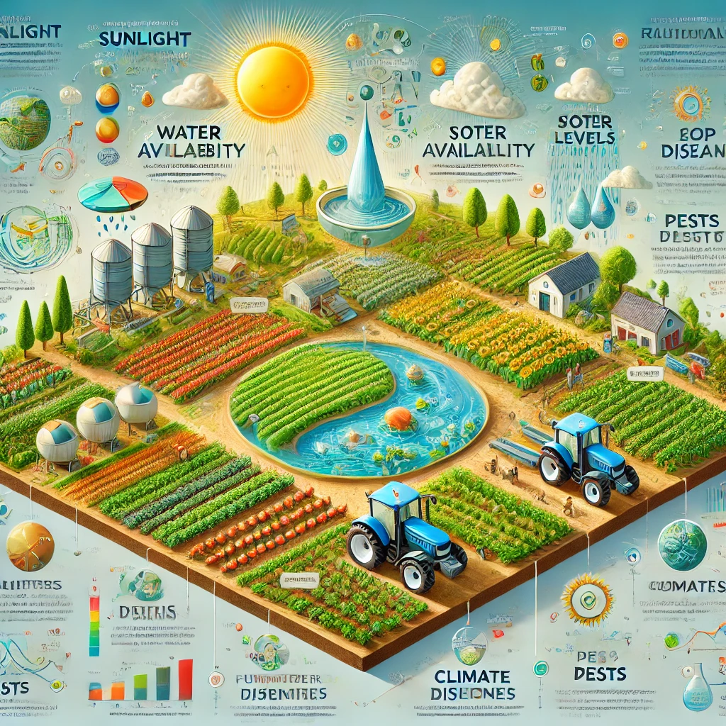
Dataset details:
State: Name of the state in India.
District: Name of the district within the state.
Crop: Type of crop being reported.
Year: Year of the reported data.
Season: Season in which the crop was grown.
Area: Total area used for cultivation.
Area Units: Units in which the area is measured (e.g., hectares).
Production: Total production of the crop.
Production Units - Units of measurement for production (e.g., tons).
Yield: Productivity of the crop (e.g., production per unit area).
Zone: Zone classification for the state (i.e, here geographical zone).

Slide 5
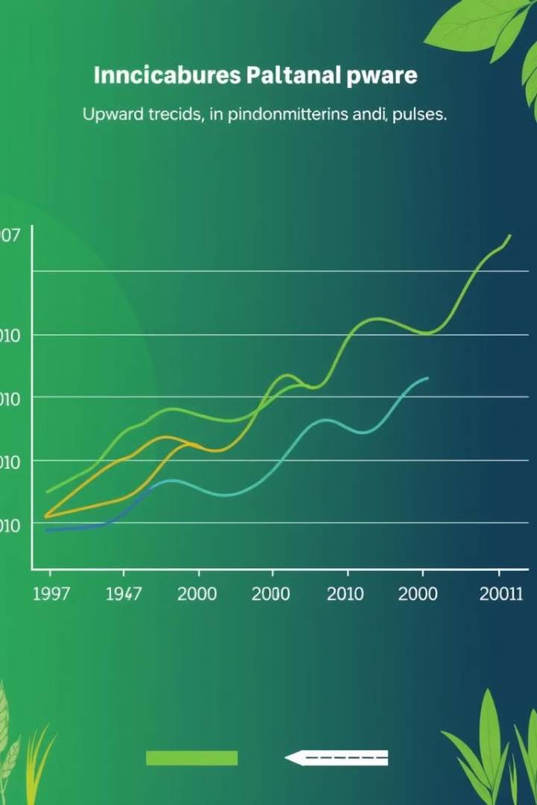
National Trends in Production and Yield
1
India's agricultural production witnessed significant growth in the period, with average annual production increasing substantially. This growth was driven by advancements in technology, irrigation, and improved crop varieties.
2
Yields per unit area also improved significantly, indicating that the increase in production is not only due to expanding cultivated land, but also due to higher efficiency.

Slide 6
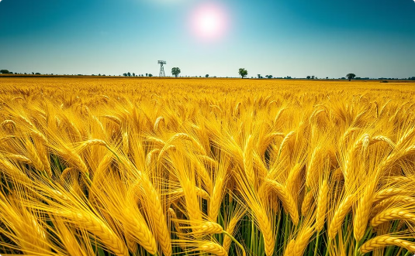
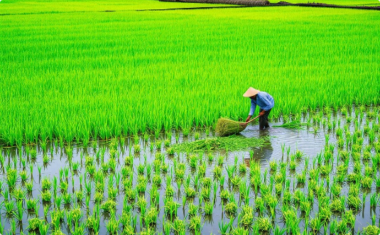

Regional Variations in Major Crops
Northern Plains
Eastern India
Southern India
The Northern Plains, dominated by wheat, rice, and pulses, are known for their fertile soil and abundant water resources.
Eastern India, characterized by rice cultivation, is a major rice producer, with its favorable climate and extensive deltaic regions supporting large-scale rice production.
Southern India, diverse in its crop mix, produces various crops, including rice, pulses, oilseeds, and cotton. The region's unique climate and soil conditions support a variety of agricultural practices.

Slide 7
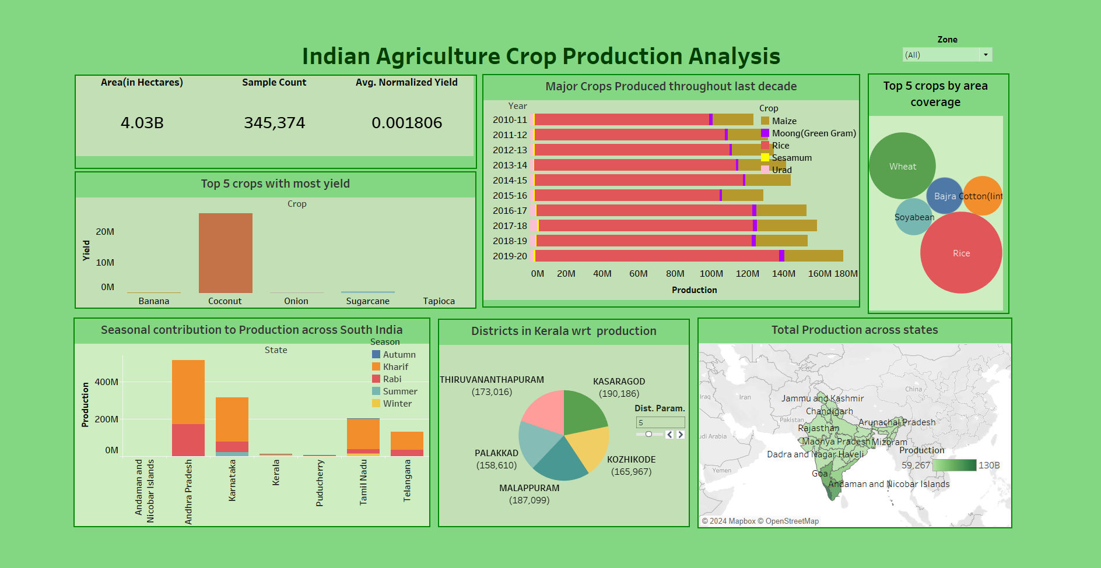
Dashboard Preview

Slide 8
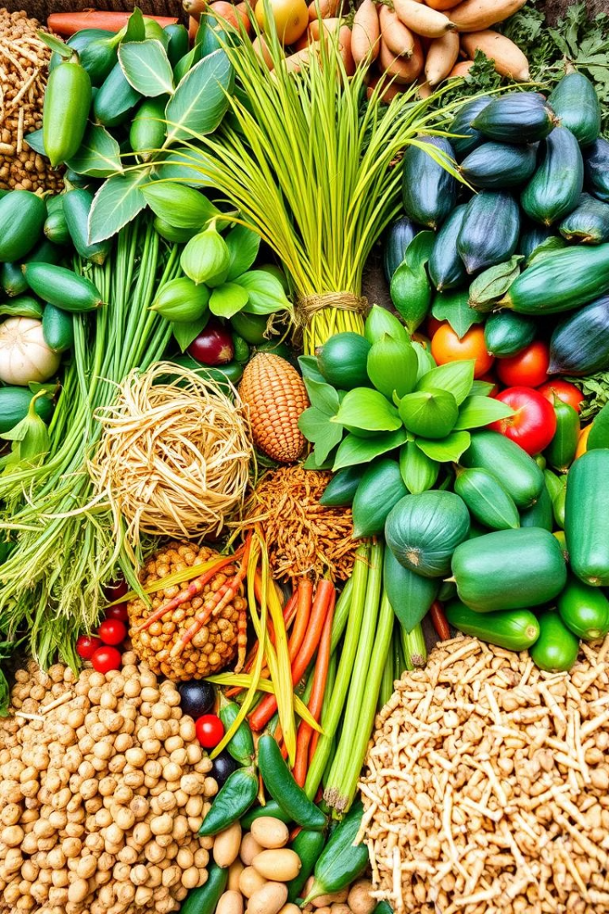
Conclusion and Key Takeaways
1.Total Area and Yield:
The total cultivated area is 4.03 billion hectares, with an average normalized yield of 0.001806.
The sample size for the data analysis is 345,374.
Top Crops by Yield:
Coconut shows the highest yield among the top 5 crops (Coconut, Sugarcane, Banana, Onion, Tapioca).
Top Crops by Area Coverage:
Rice, Wheat, Bajra, Soybean, and Cotton dominate in terms of area coverage.
Trends in Crop Production:
Major crops, such as Maize, Rice, and Urad, show a steady production trend over the years, with Rice having the most significant contribution.

Slide 9
Seasonal Contribution:
Andhra Pradesh has the highest seasonal production, with contributions primarily from the Kharif and Rabi seasons.
Other states like Karnataka, Kerala, Tamil Nadu, and Puducherry have varied seasonal contributions.
District-wise Production in Kerala:
Kasaragod leads in production, followed by Malappuram, Kozhikode, Palakkad, and Thiruvananthapuram.
State-wise Total Production:
States like Andhra Pradesh and Tamil Nadu have significantly higher production levels compared to others.
The Indian agricultural sector has achieved remarkable progress, but challenges remain. The future of agriculture lies in fostering sustainable practices, supporting farmer livelihoods, and ensuring food security for a growing population.

Slide 10





Implications for Policymakers and Farmers
Sustainable Practices
1
Promote sustainable agricultural practices to address climate change, conserve natural resources, and ensure long-term productivity.
Infrastructure Development
2
Invest in better irrigation infrastructure, storage facilities, and rural infrastructure to support agricultural growth and reduce post-harvest losses.
Technology Adoption
3
Encourage farmers to adopt modern technologies and precision farming techniques to improve efficiency and resource use.
Market Access
4
Improve market access for farmers to ensure fair prices for their produce and reduce dependence on intermediaries.
Policy Support
5
Develop policies that support farmers' livelihoods, ensure food security, and promote sustainable agricultural practices.

Slide 11
Data Sources and Methodology
Data Sources
Methodology
The dataset utilized in this project has been sourced from a popular online platform known as Kaggle, which hosts a wide variety of datasets for data analysis and machine learning purposes.
Analysis involved studying trends in production, yield, and area harvested for major crops. We also considered factors like climate, irrigation, and technology.
A Tableau dashboard was created to visualize the data. Tableau transforms raw data into interactive charts and dashboards, enabling quick insights and data-driven decisions.

Slide 12
Thank You…

